Slide 1


BashaConnect
Tamil-English Speech Translator
This project aims to develop a website for seamless speech translation between Tamil and English. This will enable clear communication between people who may not speak the same language, bridging language barriers.
Guha Pranav Yelchuru 22BCE1462 Parthan C 22BCE1053

Slide 2


Problem Statement
The challenge is to create a translator that can accurately capture the nuances of Tamil and English speech, preserving the meaning and emotion behind the words.
Contextual Understanding
Semantic Accuracy
The translator should be able to understand the context of the conversation and translate accordingly.
The translator should accurately capture the meaning of the words and phrases being spoken.
Emotional Nuance
The translator should be able to convey the emotion behind the words, whether it be happiness, sadness, anger, or any other emotion.

Slide 3
Lets us take you through our journey!!
Feasibility Report
1
Assess the technical, economic, and operational feasibility of the Tamil-English-Tamil speech translator project. Identify potential challenges and risks.
2
Design
Develop the overall system architecture and key components, including the text-to-speech, translation, and speech-to-text modules.
Prototype
3
Implement a basic prototype that can translate a few common everyday phrases between Tamil and English, in both directions.
4
Testing
Create a comprehensive testing plan to validate the accuracy, reliability, and usability of the speech translator system.
User Manual
5
Prepare clear and concise documentation to guide users on how to effectively utilize the Tamil-English-Tamil speech translator.
6
Individual Reflection
Reflect on the key skills and experiences gained through this project, and how they will be valuable for your future career.

Slide 4
Technical Feasibility
Developing a Tamil-English-Tamil speech translator is technically feasible, thanks to advances in natural language processing (NLP) and speech recognition.
Language Models
Translation APIs
Speech Recognition and Synthesis
Pre-trained language models like GPT-3 can be leveraged to understand and translate both languages.
Google Cloud Translation, Microsoft Azure Translator, and other translation APIs can be integrated for efficient and accurate translation.
APIs like Google Cloud Speech-to-Text and Text-to-Speech can convert speech to text and vice versa, enabling a smooth speech-to-speech translation experience.

Slide 5

Project Modules
The project will be built with two key modules, each with specific functionalities.
1
2
Text-to-Speech and Vice Versa
Translation Module
This module will capture voice input, convert it to text, translate it, and then convert the translated text back to speech.
This module will focus on accurate and culturally sensitive translation between Tamil and English text.

Slide 6





Workflow
This module will handle the conversion between speech and text, ensuring accurate translation and clear audio playback.
Voice Input Capture
The module will use speech_recognition to capture user speech in Tamil.
Speech Recognition
The module will use speech_recognition to convert the captured Tamil speech to text.
Text Translation
The module will utilize the google-translate API to translate the recognized Tamil text into English.
Text-to-Speech (English)
The module will use gtts (Google Text-to-Speech) to convert the translated English text back to speech.
Playback Translated Speech
The module will play the translated English speech using an appropriate audio playback library or tool.

Slide 7

Translation Module
This module ensures accurate and culturally sensitive translation between Tamil and English text. The module will handle input, translation, error handling, and output display.
1
Text Input Handling
2
Translation (Tamil to English and Vice Versa)
The module will capture text input from the user in either Tamil or English, validating the input to ensure it is in the correct language and format.
The module will use the google-translate API to perform translations between Tamil and English, ensuring contextual and cultural sensitivity.
3
Error Handling and Validation
4
Display Translated Text
The module will implement error handling for API errors, network issues, and invalid inputs, validating the translated text to ensure it meets the required standards of accuracy and appropriateness.
The module will display the translated text to the user in a user-friendly format, providing options for the user to listen to the translated text using the Text-to-Speech functionality.

Slide 8

Implementation Details
The project will be implemented using a variety of technologies and libraries.
Frontend
Backend
Database
APIs
Technologies
HTML, CSS, JavaScript
Python, Flask
MySQL , if needed
Speech_recognition, gTTS, deep_translate

Slide 9




Ethical and Legal Considerations
It is crucial to prioritize ethics and legal compliance in the development and deployment of the translator.
Cultural Sensitivity
Privacy and Data Security
Accessibility
Translations should be respectful of cultural nuances and avoid causing offense.
Robust security measures should be implemented to protect user data and speech inputs, ensuring compliance with relevant data protection regulations like GDPR.
The website should be accessible to users with disabilities by implementing features like screen reader support and keyboard navigation.

Slide 10
Usage of NLP models and Hugging face transformers?
Economic Feasibility
Operational Feasibility
The project has significant initial costs for hardware, software, and training data. However, potential revenue streams like subscriptions, enterprise solutions, and ads make it economically viable long-term. A detailed cost-benefit analysis shows the project is financially feasible.
The organization has the capability to develop, deploy, and maintain the speech translator. Key requirements include skilled NLP and speech processing developers, support staff, and effective management structures. Training programs will keep the team up-to-date on the latest advancements.

Slide 11
Market and Risks
Market Feasibility
Risk Analysis
There is significant demand for a Tamil-English-Tamil speech translator in educational, business, and government settings where multilingual communication is crucial. Competitive analysis will identify existing solutions and highlight the unique value proposition of the contextual approach. Marketing will focus on the translator's accuracy, cultural sensitivity, and ease of use to appeal to users who require reliable and nuanced translations.
Key risks include technical inaccuracies in speech recognition and translation, financial constraints, legal compliance, and operational challenges in coordinating the project team. Robust mitigation strategies will be developed, such as regular technical audits, legal reviews, and contingency planning, to effectively address these challenges.

Slide 12
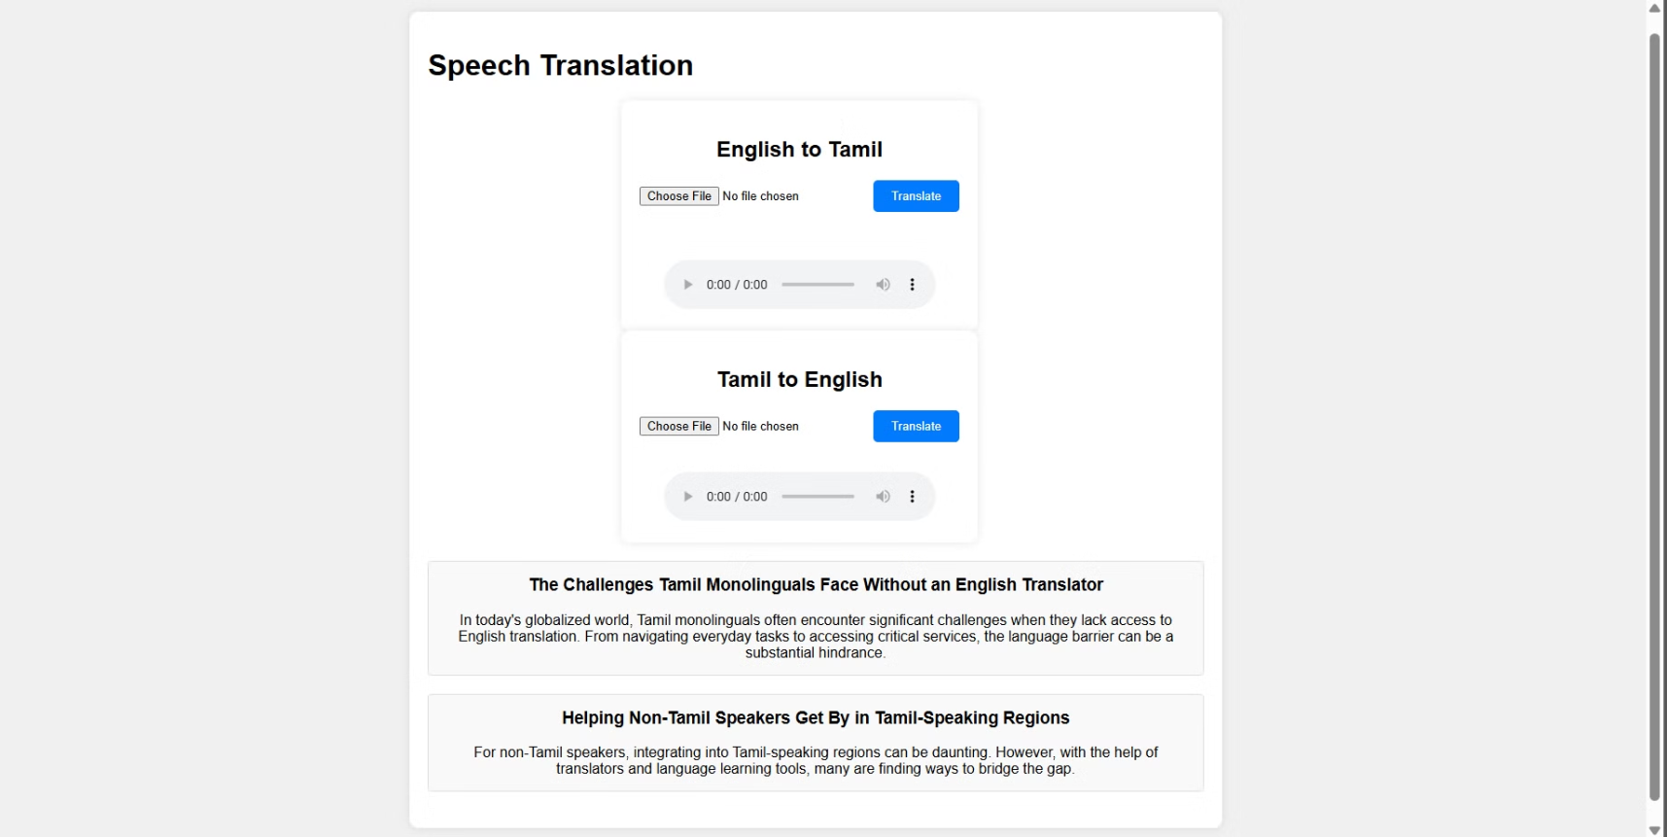
Prototype? Here you go…

Slide 13
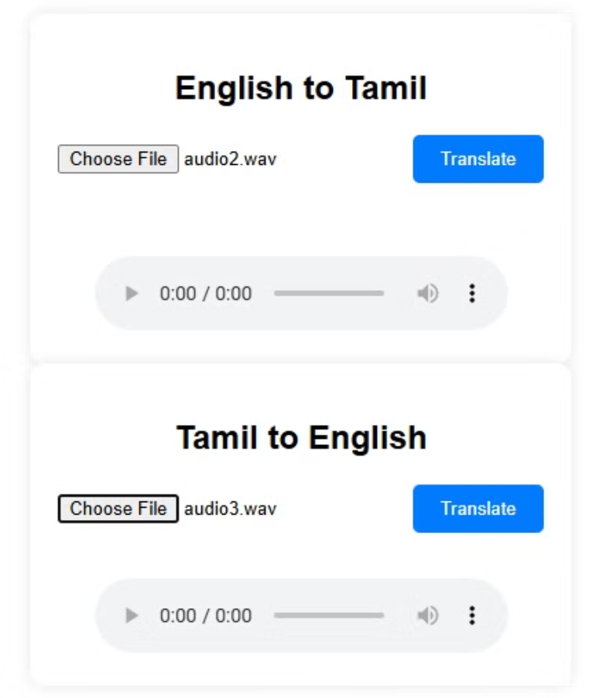

Slide 14
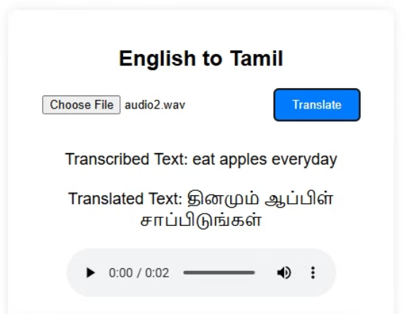
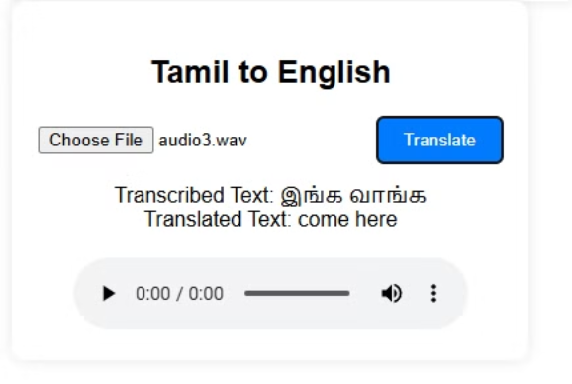
Testing!!

Slide 15

User Manual: Speech Translation Website
Our website features two containers for Tamil-English and English-Tamil translation. Simply upload an audio file, click "Translate," and view the transcribed and translated text. The translated audio file is also available for seamless communication.
Easy? Well yes, basic UI for a large target audience.

Slide 16
Individual Reflections
Pranav: As a native Tamilian, I'm thrilled about the prospect of my language gaining greater reach and visibility through this translation tool. Tamil is a rich and vibrant language with a long and storied history, and I believe it deserves to be heard on the global stage. This service will make it easier for Tamil speakers to connect and communicate with those who don't share our linguistic heritage, opening up new avenues for cultural exchange, collaboration, and mutual understanding.
Parthan: As a Malayali student studying in Chennai, I'm incredibly excited about this speech translation tool. It will be invaluable in my daily life, allowing me to navigate the city and engage with my Tamil-speaking peers and professors with greater ease and confidence. I'm especially enthusiastic about the two-way translation capabilities, as it will facilitate meaningful dialogue and strengthen the bonds between our communities.

